Slide 1
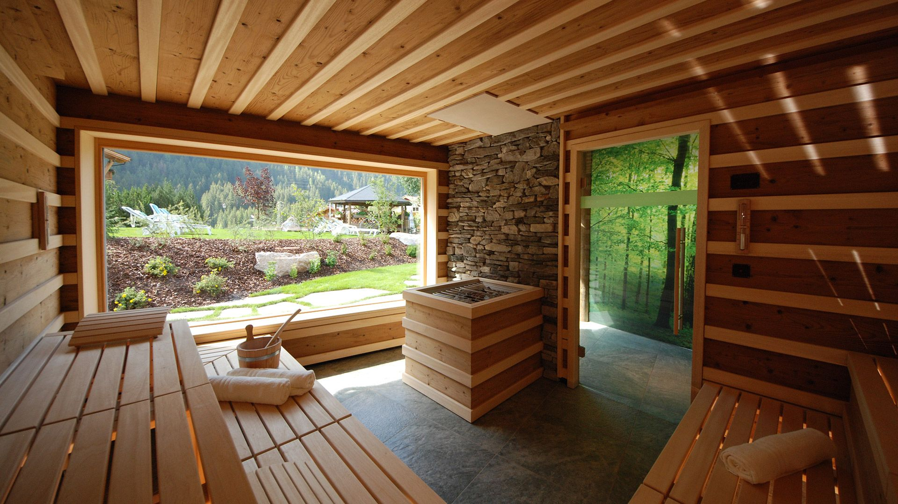
SteemY
Kristófer Knutsen
Vladimir Moroz
GeonHui Yoon (Jamie)
07.05.2018

Slide 2
Outline
Project Goals
Application Introduction
Application Function
Project Overview
Milestones
Business Ideas
Conclusion
References

Slide 3
Project Goals
Develop Application With Cloud Integration
Provide Overview For Sauna Owners
Create User-Friendly Application
Implement GPS Distance Calculation

Slide 4

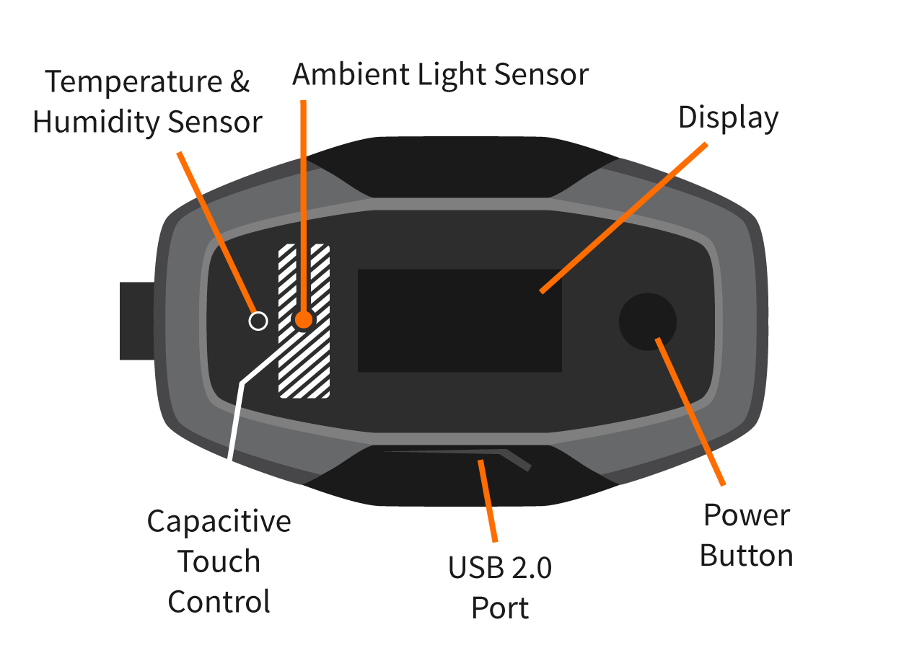
What is SteemY?
Sauna Status Application
Wireless Metering Via Cloud
Visualization Of Sensor Data

Slide 5


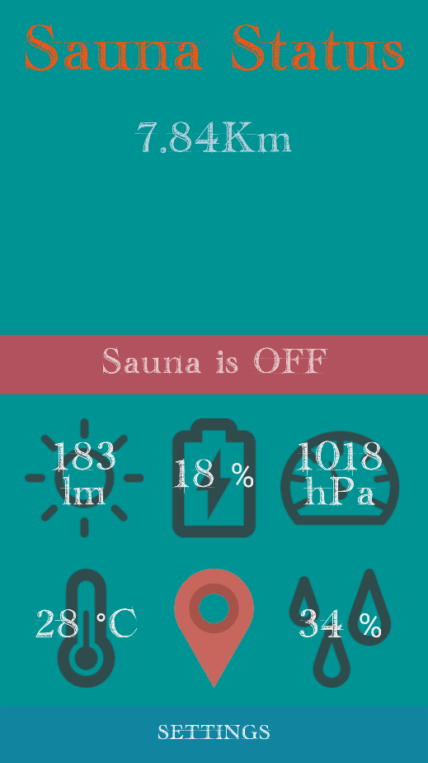
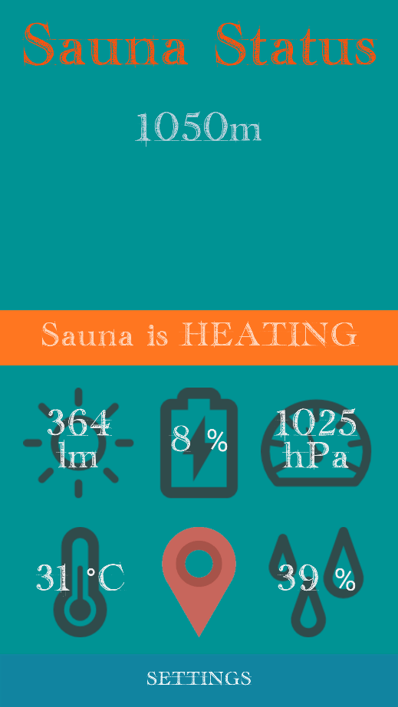
SteemY Functions

Slide 6
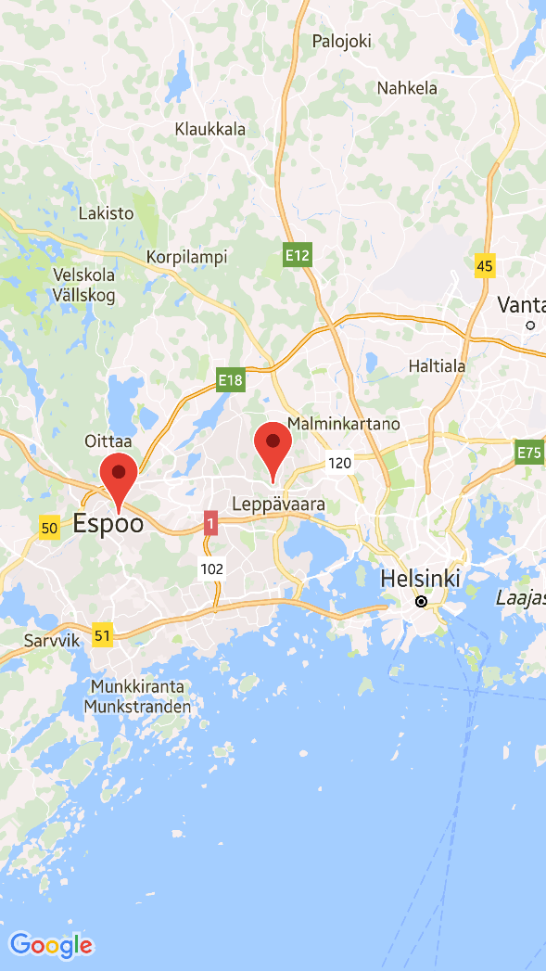
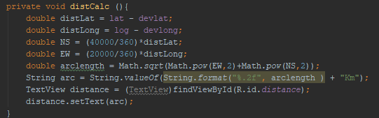
SteemY Functions
GPS Coordinates
Sensor Data
Distance Calculation

Slide 7
Project Overview
Problems
Solutions
Thingsee Cloud Service
Sensor Data Impresice
GPS Data
Android Studio SDK
Project Sharing
Utilize Different Account
Compinsate For Inaccurasy
Test Application Outdoors
Apply Proper Work Division

Slide 8
Milestones

Slide 9

Business Ideas
Future Expansions
Smart Sauna Integration
Local Sauna Locator
Increased Sensor Availability

Slide 10

Conclusion
Application Goals Achieved
Great Learning Experience
Room For Future Improvements
Team Skills Increased
Division Of Labour Improved

Slide 11
References
Applications & Equipment
Content & Design
Thingsee One
Thingsee Cloud
Android Studio
Trello
GitHub
Google Drive
Sauna Picture. http://thermarium.com/en/portfolio/manufaktur/heat-steam/sauna/
Thingsee Picture. https://app.thingsee.com/assets/content/start/device-overview.svg

